Slide 1
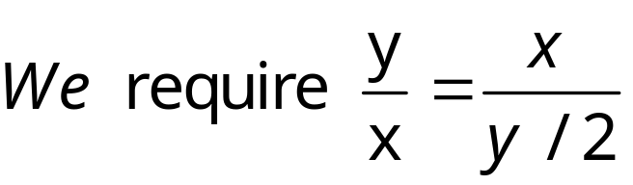
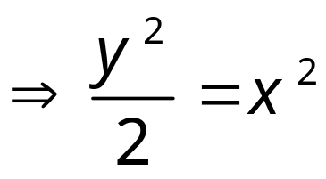
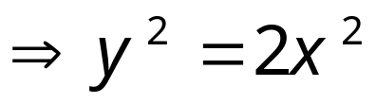
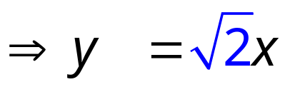
Paper Sizes
What shape should a piece of paper be, so that, if cut or folded in half, the new piece would be exactly the same shape as the original?
Mathematically this means that the rectangles have to be similar, that is, their length to width ratios must be the same.
x
y/2
y

Draw a rectangle with any random width and make its length √2 times longer. Then cut it out and try repeated folding.

Slide 2
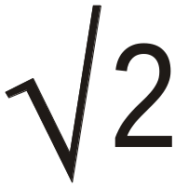
“A” Paper Sizes
The system of “A” paper sizes is based on this principle. This sizing method is very useful since it :
Eliminates wastage at the point of production.
Provides a range of practical and conveniently sized paper for consumer use.
Enables easy enlargement/reduction of documents on a photocopier from one “A” size to another.
A3
A4
A5
A6

Slide 3
A0
1189 mm
A4
A3
A8
A7
A9
A5
A10
A6
A1
841 mm
A2
A0 = 1189 x 841 = 999 949 mm² ≈ 1m²

Slide 4
A2
A3
A4
A5
A6

Slide 5
Q1. How many pieces of each “A” size can be cut from the original 1 m² ?
Q2. Why is A0 so called?
A0 | 1 | 2⁰
A1 | 2 | 2¹
A2 | 4 | 2²
A3 | 8 | 2³
A4 | 16 | 2⁴
A5 | 32 | 2⁵
A6 | 64 | 2⁶
A7 | 128 | 2⁷
A8 | 256 | 2⁸
A9 | 512 | 2⁹
A10 | 1024 | 2¹⁰

Slide 6
International Standard Paper Sizes
The ISO 216 paper size system is a metric system based on the constancy of the √2 aspect ratio. The standard consists of types A, B and C paper sizes, as shown below(mm). The USA and Canada are the only industrialised countries that have not yet adopted the system. Letter/Legal and Executive sizes are widely used in these countries.
A0
841 x 1189
B0
1000 x 1414
C0
917 x 1297
A1
594 x 841
B1
707 x 1000
C1
648 x 917
A2
420 x 594
B2
500 x 707
C2
458 x 648
A3
297 x 420
B3
353 x 500
C3
324 x 458
A4
210 x 297
B4
250 x 353
C4
229 x 324
A5
148 x 210
B5
176 x 250
C5
162 x 229
A6
105 x 148
B6
125 x 176
C6
114 x 162
A7
74 x 105
B7
88 x 125
C7
81 x 114
A8
52 x 74
B8
62 x 88
C8
57 x 81
A9
37 x 52
B9
44 x 62
C9
40 x 57
A10
26 x 37
B10
31 x 44
C10
28 x 40

Slide 7
The ISO standard paper size covers a wide range of formats but not all of them are widely used in practice. Among all formats A4 is clearly the most important one for daily office use. Some main applications of the most popular formats are summarized in the adjacent table:
A0, A1
Technical drawings, posters
A2, A3
Drawings, diagrams, large tables
A4
Letters, magazines, forms, catalogues, printer and photocopier output
A5
Note pads
A6
Postcards
B5, A5, B6, A6
Books
C4, C5, C6
Envelopes for A4 letters: unfolded C4, folded once C5, folded twice C6
B4, A3
Newspapers supported by most copying machines in addition to A4
B8, A8
Playing cards
An EU passport is size B7
Source: Markus Kuhn
A0
841 x 1189
B0
1000 x 1414
C0
917 x 1297
A1
594 x 841
B1
707 x 1000
C1
648 x 917
A2
420 x 594
B2
500 x 707
C2
458 x 648
A3
297 x 420
B3
353 x 500
C3
324 x 458
A4
210 x 297
B4
250 x 353
C4
229 x 324
A5
148 x 210
B5
176 x 250
C5
162 x 229
A6
105 x 148
B6
125 x 176
C6
114 x 162
A7
74 x 105
B7
88 x 125
C7
81 x 114
A8
52 x 74
B8
62 x 88
C8
57 x 81
A9
37 x 52
B9
44 x 62
C9
40 x 57
A10
26 x 37
B10
31 x 44
C10
28 x 40

Slide 8



A0
841 x 1189
B0
1000 x 1414
C0
917 x 1297
A1
594 x 841
B1
707 x 1000
C1
648 x 917
A2
420 x 594
B2
500 x 707
C2
458 x 648
A3
297 x 420
B3
353 x 500
C3
324 x 458
A4
210 x 297
B4
250 x 353
C4
229 x 324
A5
148 x 210
B5
176 x 250
C5
162 x 229
A6
105 x 148
B6
125 x 176
C6
114 x 162
A7
74 x 105
B7
88 x 125
C7
81 x 114
A8
52 x 74
B8
62 x 88
C8
57 x 81
A9
37 x 52
B9
44 x 62
C9
40 x 57
A10
26 x 37
B10
31 x 44
C10
28 x 40
The B paper sizes were introduced to offer more choice over A sizes. They are larger than their corresponding A size. The C paper size is primarily used for envelopes. An A4 letter fits nicely into a C4 envelope.

Slide 9
A0
841 x 1189
B0
1000 x 1414
C0
917 x 1297
A1
594 x 841
B1
707 x 1000
C1
648 x 917
A2
420 x 594
B2
500 x 707
C2
458 x 648
A3
297 x 420
B3
353 x 500
C3
324 x 458
A4
210 x 297
B4
250 x 353
C4
229 x 324
A5
148 x 210
B5
176 x 250
C5
162 x 229
A6
105 x 148
B6
125 x 176
C6
114 x 162
A7
74 x 105
B7
88 x 125
C7
81 x 114
A8
52 x 74
B8
62 x 88
C8
57 x 81
A9
37 x 52
B9
44 x 62
C9
40 x 57
A10
26 x 37
B10
31 x 44
C10
28 x 40
Each B size is derived from the Geometric Mean of its corresponding A size together with the one previous. This preserves the √2 aspect ratio and gives similarity between corresponding A and B sizes with a scale factor of enlargement of ⁴√2 = 1.19… This enables ready enlargement/reduction between A and B sizes on a photocopier.
So B4 width = √(210 x 297) = 250 mm and B4 length = √(297 x 420) = 353 mm
Also ⁴√2 x 210 = 250mm and ⁴√2 x 297 = 353 mm

Slide 10
A0
841 x 1189
B0
1000 x 1414
C0
917 x 1297
A1
594 x 841
B1
707 x 1000
C1
648 x 917
A2
420 x 594
B2
500 x 707
C2
458 x 648
A3
297 x 420
B3
353 x 500
C3
324 x 458
A4
210 x 297
B4
250 x 353
C4
229 x 324
A5
148 x 210
B5
176 x 250
C5
162 x 229
A6
105 x 148
B6
125 x 176
C6
114 x 162
A7
74 x 105
B7
88 x 125
C7
81 x 114
A8
52 x 74
B8
62 x 88
C8
57 x 81
A9
37 x 52
B9
44 x 62
C9
40 x 57
A10
26 x 37
B10
31 x 44
C10
28 x 40
Each C size is derived from the Geometric Mean of its corresponding A and B size. This ensures similarity between all 3 sizes with a scale factor of enlargement from A to C of 1.09… and from C to B of 1.09…
So C4 width = √(210 x 250) = 229 mm and C4 length = √(297 x 353) = 324 mm

